Slide 1
WinWin
Milestone 2 Project Proposal Presentation
By G14 Waterfall

Slide 2
Contents
Introduction
SDLC Methodology
Problem statements
Work Plan and Team Organization
As-is and To-be system
Feasibility Analysis

Slide 3

Introduction
Motorcycle taxi is the second most used transportation in Bangkok, besides MRT.
Other Ride-hailing applications reduced customer count of motorcycle taxis.
Digitalization of the motorcycle taxi system.

Slide 4
Organization background
Matchmaking between customers and motorcycle taxis.
Department of Land Transport, Ministry of Transport is one of our partners.
Winnonie, a startup from Bangchak Corporation, is also one of our partners.
Motorcycle taxis are more familiar with the local route.
Provide chances for motorcycle taxis to make more income.
Reduce waiting time for customers.
Support locals.

Slide 5
Problem statements & Proposed solutions
Problems
Solutions
Inconvenience of accessing & using motorcycle taxis.
Pricing over the legal price limits.
Reliability issues of motorcycle taxis.
Create a mobile application that customers can call motorcycle taxi anywhere.
Create price estimation system that corresponds with the legal prices.
Create review system that customers can review the riders.

Slide 6

As-is system
Customer
start location.
Customer
destination.
Customer books a ride and
selects destination via Line OA
Rider takes customer to the destination.
Admin receives customer request and forwards to the rider nearby.
Customer makes a payment and reviews the service.
Rider travels to customer’s location, updates status with admin regularly.

Slide 7
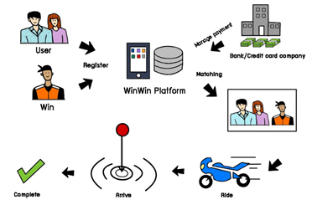
To-be system
Customer and Rider register to the system.
Customer selects pick-up location and destination.
Customer selects payment method.
Customer selects rider preference.
Update current status to the system.
After arriving at the destination, customer can review their rider.

Slide 8
The Scopes of The Project
Functional
Non-Functional
Register and manage account
Login/Logout system
Match a rider to the user
Book a ride
Initiate a ride
Make payment
Make review
Operational requirements
Performance requirements
Security requirements
Usability requirements

Slide 9
SDLC methodology
Throwaway Prototyping
Reasons:
1. WinWin's CTO is inexperienced with Mobile-based Application Development.
2. Some problems do not yet have a clear solution.
3. The functionality of the features is still inconsistent.
4. There is enough time to deliver the final system.

Slide 10
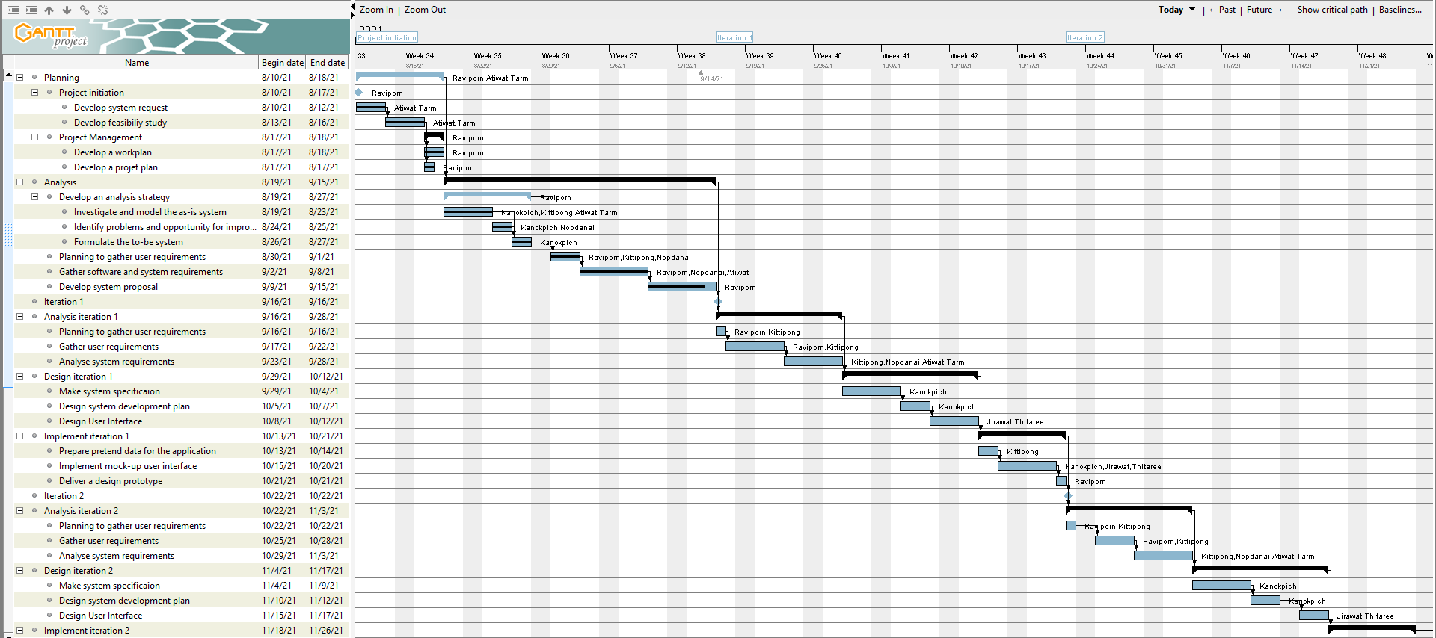
Gantt chart

Slide 11
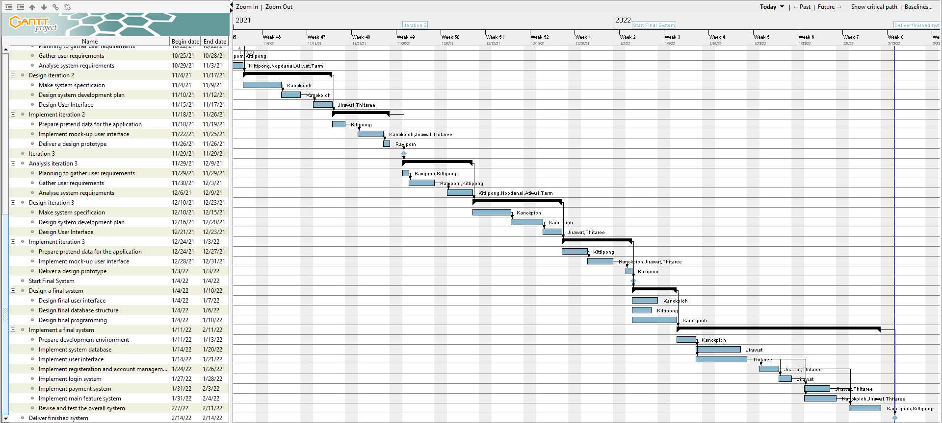
Gantt chart

Slide 12
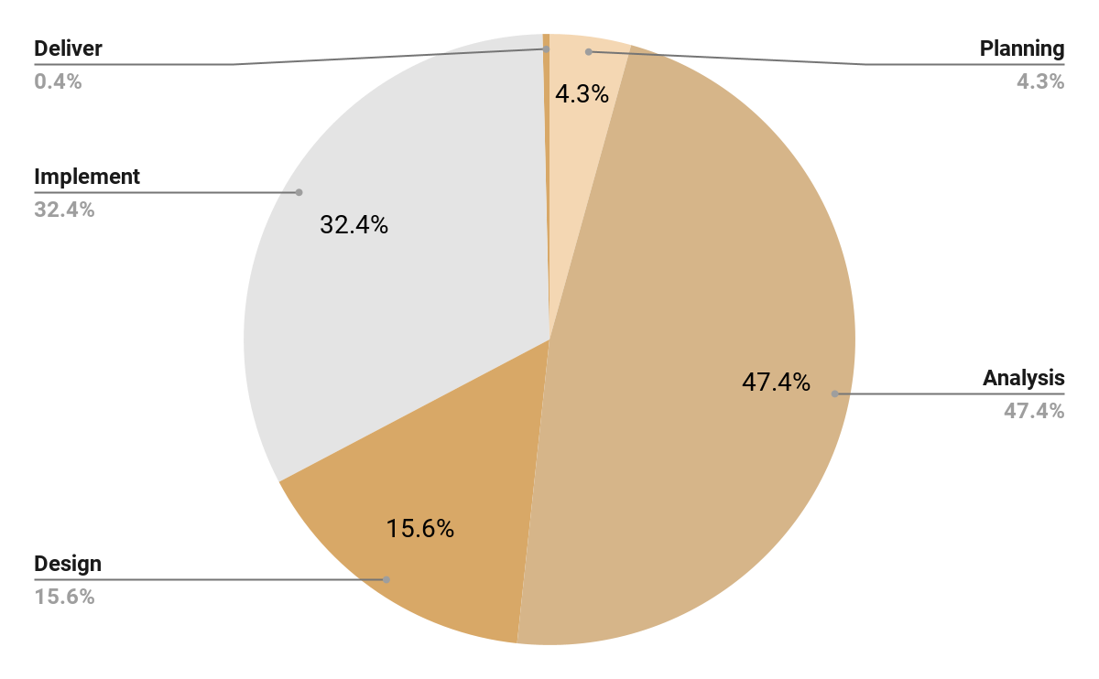
Cost estimation
1,800 THB
21,100 THB
158,650 THB
232,400 THB
76,450 THB
Total: 490,400 THB

Slide 13
Team organization
1
1
Project Manager
Business Analyst
1
1
Technical Leader
Infrastructure Analyst
2
2
Software Developers
System Analysts

Slide 14
The Results of Feasibility Study

Slide 15
Technical feasibility
RISK
Functional Area | - Team is not familiarized with logistics and traveling businesses. - Even though we are fast-learners, some application’s features are complex with many details. | M
Technical Area | - Team have experience in making web application and a good understanding of how website works, including technical tools. - But the team is inexperienced in making mobile application. - Application is complex with high user count and concurrency. | M
Project Size | - Large, comparing to a team of 8. - Was given long time to develop (6 months), have enough time for trial-and-error and learning. | L
Compatibility | - Low. - The as-is system is an LINE OA, but to-be system is a mobile application. - The to-be system wants to digitalize the existing motorcycle taxi system, the difference is huge. | H
Summary of Technical feasibility level |  | M

Slide 16
Economic feasibility
Tangible Benefits
Increase income of motorcycle taxis
The company receives income from 8% of fares.
Intangible Benefits
Increase customer satisfaction
Improve the reliability and image of motorcycle taxis
Summary of Economic feasibility level = High

Slide 17
Economic feasibility
 | 2021 | 2022 | 2023 | 2024 | 2025 | 2026 | 2027 | 2028 | Total
Total benefits | 0.00 | 2,635,200.00 | 28,717,200.00 | 45,537,200.00 | 50,845,760.00 | 57,004,040.00 | 61,401,444.00 | 67,543,728.00 | 313,684,572.00
PV of benefits | 0.00 | 2,483,928.74 | 26,280,306.06 | 40,459,212.40 | 43,859,999.22 | 47,739,986.07 | 49,924,992.90 | 53,319,642.60 | 264,068,067.99
PV of all benefits | 0.00 | 2,483,928.74 | 28,764,234.80 | 69,223,447.20 | 113,083,446.42 | 160,823,432.49 | 210,748,425.39 | 264,068,067.99

Slide 18
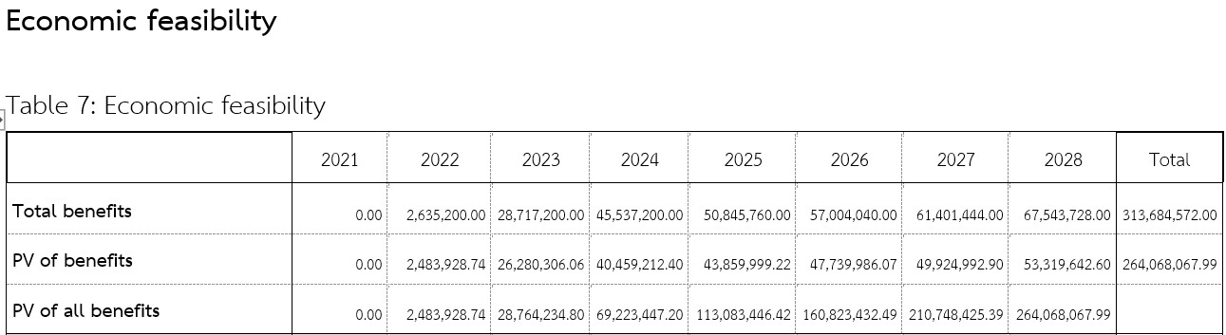
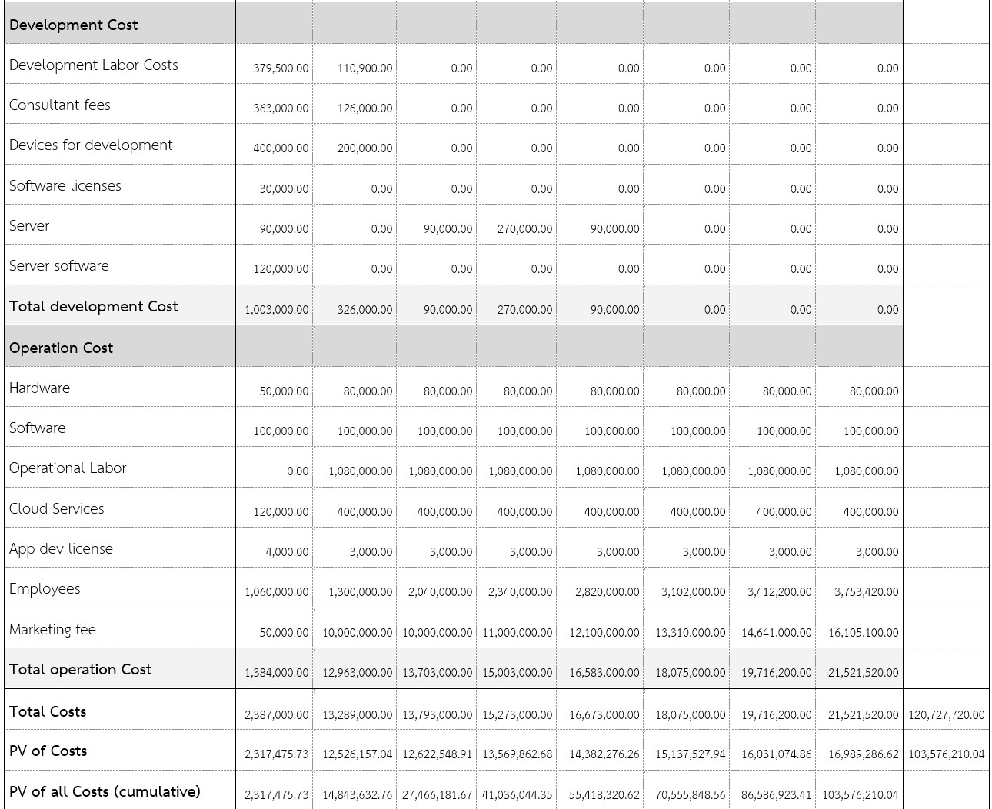

Slide 19
Economic feasibility
 | 2021 | 2022 | 2023 | 2024 | 2025 | 2026 | 2027 | 2028 | Total
Total Project Benefits - Costs | -2,387,000.00 | -10,653,800.00 | 14,924,200.00 | 30,264,200.00 | 34,172,760.00 | 38,929,040.00 | 41,685,244.00 | 46,022,208.00 | 192,956,852.00
Yearly NPV | -2,317,475.73 | -10,042,228.30 | 13,657,757.15 | 26,889,349.72 | 29,477,722.96 | 32,602,458.13 | 33,893,918.04 | 36,330,355.98 | 160,491,857.96
Cumulative NPV | -2,317,475.73 | -12,359,704.02 | 1,298,053.13 | 28,187,402.84 | 57,665,125.81 | 90,267,583.93 | 124,161,501.98 | 160,491,857.96
Return on Investment | 154.95 %
Break Even Point | 2.905 years

Slide 20
Organizational feasibility
RISK
Strategic alignment | Operation strategy is in line with the company’s and sponsors’ visions (Department of Land Transportation and Winnonie) who want to encourage the use of local motorcycle taxi services. | L
Stakeholder analysis | Customer Motorcycle taxi Department of Land Transport Winnonie | L

Slide 21
Organizational feasibility
Impact of the to-be system |  | ML
 | Pros | Cons
Economic Impact | - Increase economic circulation by increasing the spending and income of households. | -
Society Impact | - Increase employment of motorcycle taxi in local and encourage spending money of local. | - Riders who are not familiar with technology could not access our application, increasing inequality and alienation.
Environmental Impact | - The future plan of integrating electric motorcycles into the system will promote the use of clean energy thus decreasing air pollution. | - If motorcycle taxis continue to use petrol vehicles, the created air pollution will leads to greenhouse effect.
Global Impact | - Reduce crowdedness around motorcycle taxis spot which will decreases the spread of COVID-19. | -
Summary of Organizational feasibility level = Medium High

Slide 22
An Overall of The Three Aspects Summary
Technical Feasibility Level | Medium
Economic Feasibility Level | High
Organizational Feasibility Level | Medium-High
Overall Feasibility Level | Medium-High

Slide 23
G14 Waterfall - Members
6230123921 Thitaree Setwipattanachai
6230252121 Tarm Kalavantavanich
6231301421 Kanokpich Chaiyawan
6231304321 Kittipong Deevee
6231307221 Jirawat Kusalangkurwat
6231333521 Nopdanai Sayamnet
6231353021 Raviporn Akekunanon
6231372021 Atiwat Deepo

